Slide 1
Magenic Masters React ES6
Feb 9, 2017
Mily Opena

Slide 2
What You’ll Learn Today
ES6
Changes in React
New Features

Slide 3

About our course

Slide 4
Why Learn ES6?

Slide 5
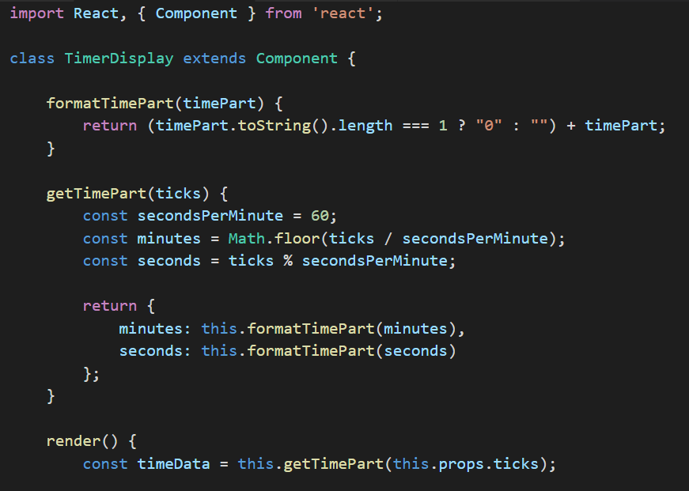

Components are more readable

Slide 6

Popular choice for React

Slide 7
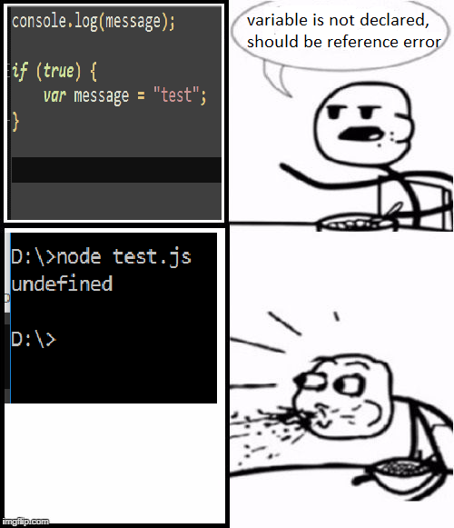
Non-hoisted Variables

Slide 8

New Features

Slide 9

ES7 is coming

Slide 10
What is ES6?

Slide 11
What is ES6?
ECMAScript 6, also known as ECMAScript 2015, is the latest version of the ECMAScript standard
It is a significant update to the language since 2009 (ES5)

Slide 12
What is ES6?
ES6 is finalized, but not fully supported by all browsers
To use ES6 today, get a compiler like Babel

Slide 13
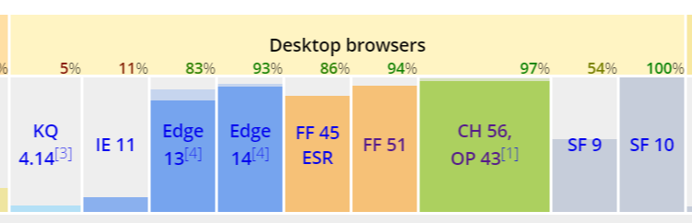
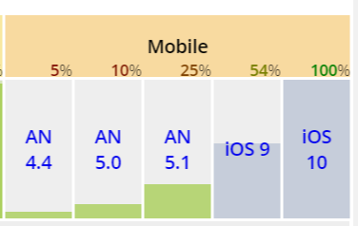
Browser Support

Slide 14
ES6 Changes/
New Features

Slide 15
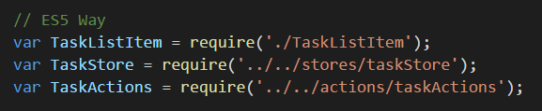
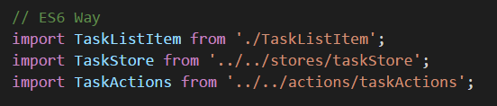
Import

Slide 16
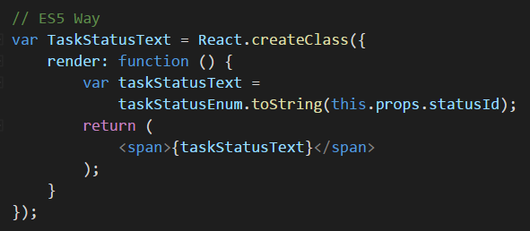
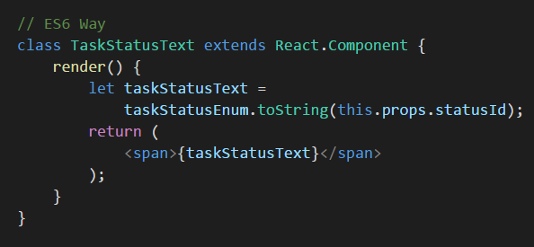
Classes
Instead of using the React.createClass method to define a component, we can define a bonafide ES6 class that extends React.Component

Slide 17
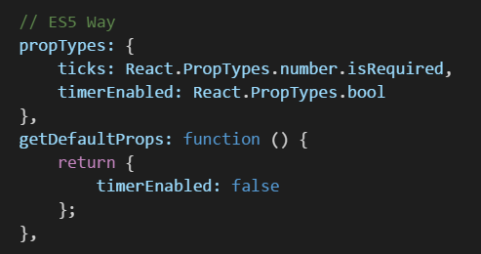
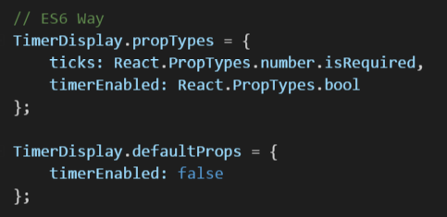
Declaring Prop Types and Default Props
propTypes and defaultProps become properties of the class itself, so they need to be tacked on to the class after it is defined.

Slide 18
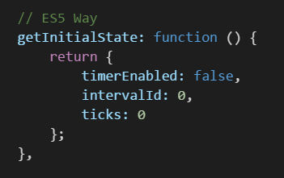
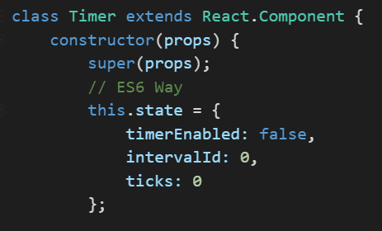
Setting the Initial State
In ES6 classes, you can define the initial state by assigning this.state in the constructor

Slide 19
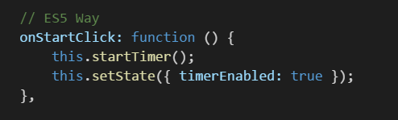
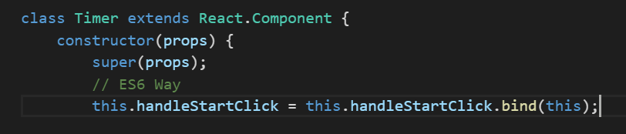
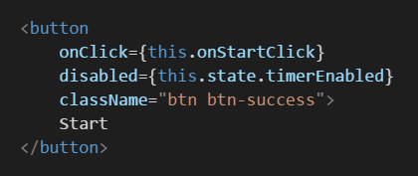
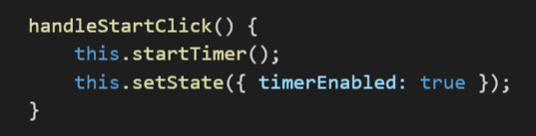
Autobinding
Methods don't automatically bind this to the instance. You'll have to explicitly use .bind(this) in the constructor

Slide 20
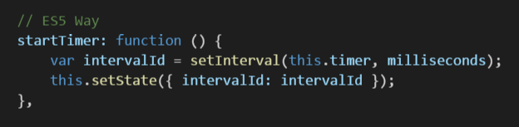
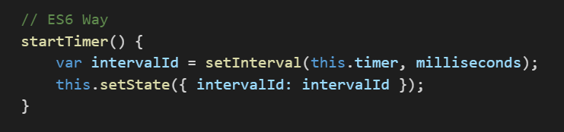
Functions
Functions are more readable inside ES6 component

Slide 21
Var, Let and Const
var – Hoisted variable
let – Based on scope only
const – cannot be reassigned
* Using var will be a deduction to your assignment and final project

Slide 22
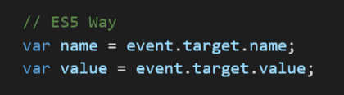

Destructuring Assignment

Slide 23
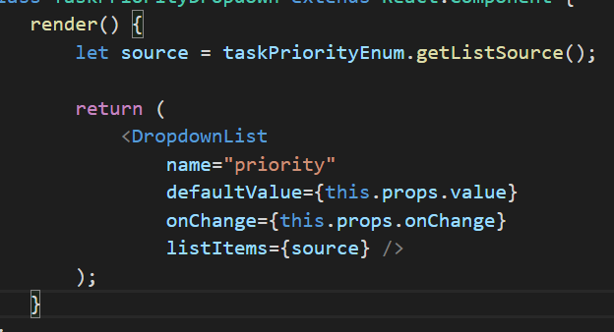
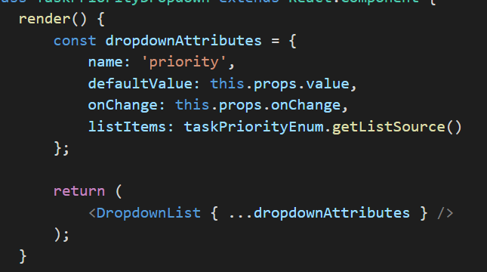
Spread
Allows an expression to be expanded in places where multiple arguments (for function calls) or multiple elements (for array literals) or multiple variables are expected

Slide 24
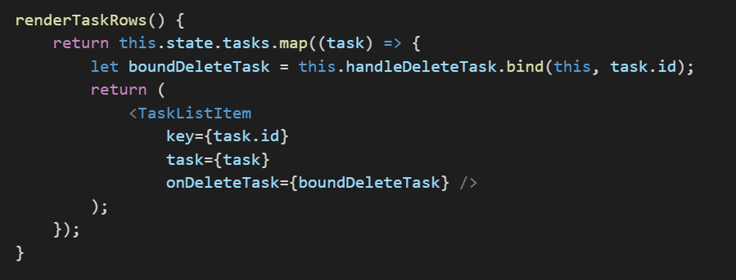
Arrow Functions
An arrow function expression has a shorter syntax than a function expression and does not bind its own this

Slide 25
Changes in ES6
Demo
Convert Wish List to ES6

Slide 26
Other Features

Slide 27
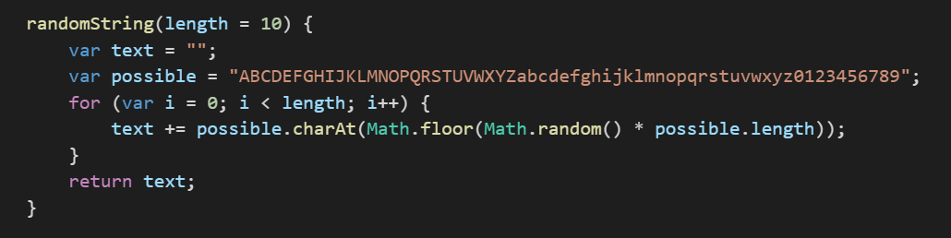
Optional Parameters

Slide 28
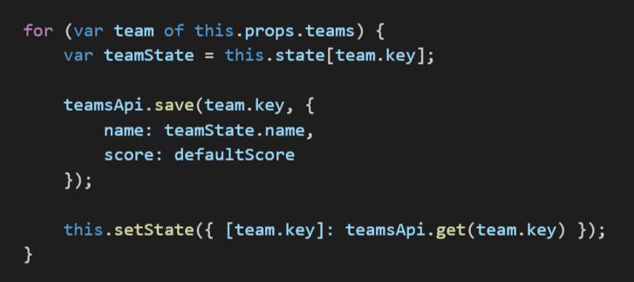
For of

Slide 29
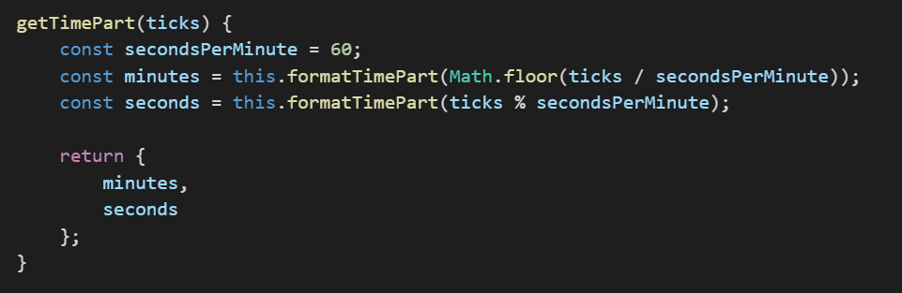
Object Literals Extension

Slide 30
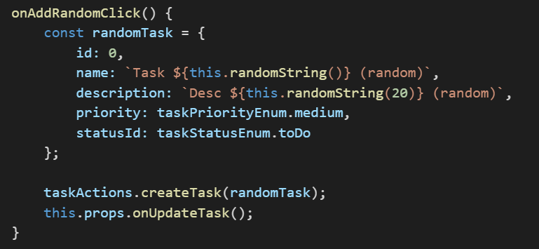
Template Literals
Must use back tick (`) character instead of quotes character

Slide 31
Assignment
Convert your project to ES6
+1 : Apply Higher-Order Component (HOC) in your app
-1 : If you use “var” in your code
Assignment #3, EOD Today

Slide 32
Agenda Next Session
Flux

